Slide 1
Gonorrhea
Kimberly Workowski, M.D, FACP, FIDSA
Professor of Medicine, Division of Infectious Diseases, Emory University

Slide 2
Disclosure
Relations that could be relevant for the meeting | Company names
Sponsorship or refund funds
Payment or other financial remuneration
Shareholder rights
Other relations (Clinical Trials Research) | Gilead (HIV, HCV) GSK (GC)

Slide 3
Outline
GC Epidemiology
Screening/Clinical Manifestations
Antimicrobial Resistance challenges
Treatment Optimization

Slide 4
GC Epidemiology

Slide 5
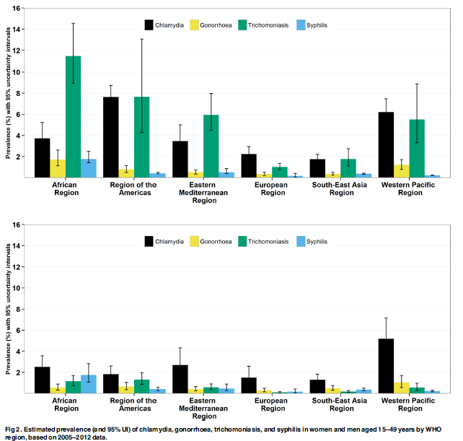
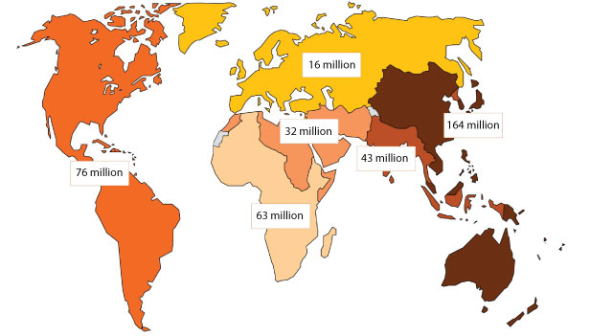
WHO Global STI Estimates of 4 Curable STIs
Curable STIs: chlamydia, gonorrhea, syphilis, trichomoniasis
Newman, PloS One 2015

Slide 6
Nationally Notifiable Diseases Ranked by Frequency, United States, 2016
Disease | Number | Rate (per 100,000 population)
Chlamydia | 1,598,354 | 494.65
Gonorrhea | 468,514 | 144.99
3. Syphilis (all stages) | 88,042 | 27.25
Campylobacteriosis | 60,120 | 18.61
Salmonellosis | 53,850 | 16.67
6. Lyme Disease (confirmed & probable) | 36,429 | 11.32
7. HIV Diagnoses | 34,775 | 10.76
Shigellosis | 21,097 | 6.53
Pertussis | 17,972 | 5.56
10. Invasive Pneumococcal Disease | 17,626 | 7.32
CDC. National Notifiable Diseases Surveillance System, 2016 Annual Tables of Infectious Diseases. Available at: https://www.cdc.gov/nndss/infectious-tables.html.
Notes:
This list shows you the 10 most reported notifiable conditions in 2016. Gonorrhea is the second most reported condition in the U.S. [click].
Additionally, you will notice, STDs take the gold, silver and bronze medals.

Slide 7
Gonorrhea — Rates of Reported Cases by Sex, United States, 2006–2017*
Rate per 100,000
During 2012-2017, the rates of reported GC increased:
112% among males
40% among females
Males
Females
*2017 data are projected estimates as of December, 2017

Slide 8
Gonorrhea – Rates of Reported Cases by Age Group, Race/Ethnicity, and Region, United States, 2007-2017* (preliminary)
2017 data are preliminary
Notes:
Rates of reported gonorrhea among men increased for all groups (15-54 years), in all race/ethnicity groups, and in all four U.S. census regions during 2007-2016.
Persons aged 15-44 account for 92% of cases in 2016.

Slide 9
Sentinel Surveillance
STD Surveillance Network (SSuN)
  10-12 state health departments
  Facility component (screening coverage, infections, risk behavior)
  Population component (interview, clinical)
Gonococcal Isolate Surveillance Project (GISP)
  GC antimicrobial susceptibility trends
  27 STD clinic sites (urethral isolates 25 men/month)

Slide 10
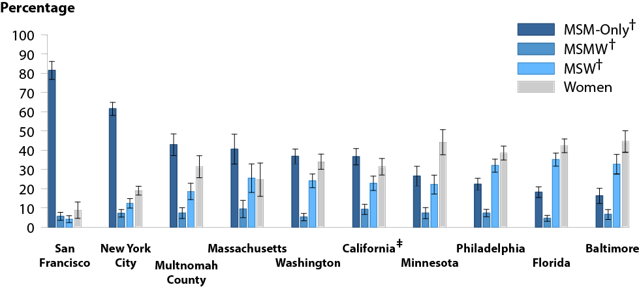
Estimated Proportion* of MSM-Only†, MSMW†, MSW†, and Women Among Gonorrhea Cases by Jurisdiction, STD Surveillance Network (SSuN), 2016

Slide 11
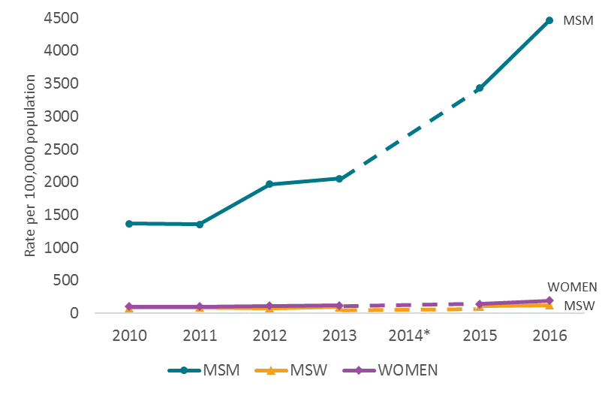
Estimated* Rates of Reported Gonorrhea Cases by MSM, MSW, and Women, SSuN, 2010-2016
Since 2010, the rate of reported GC among MSM increased 151% compared to a 40% increase among females

Slide 12
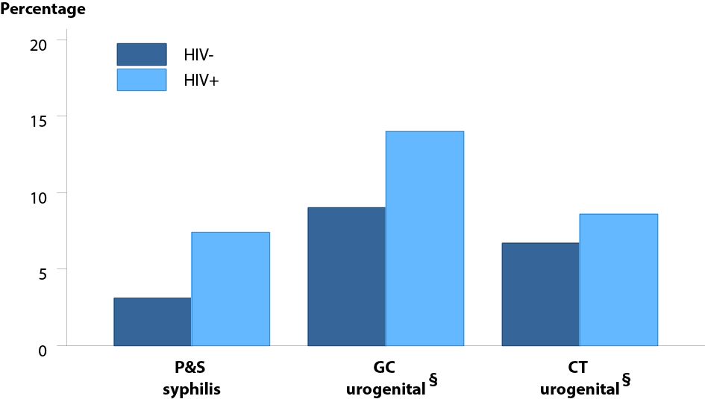
Proportion of MSM* Attending STD Clinics with Primary and Secondary Syphilis, Urogenital Gonorrhea or Urogenital Chlamydia by HIV Status†, STD Surveillance Network (SSuN), 2016

Slide 13
Screening/Clinical Manifestations

Slide 14
STI Screening
Women and Heterosexual Men
Men who Have Sex with Men
  Chlamydia, Gonorrhea
  Annual screening for women <25 or older women with risk
  Consider chlamydia screening in heterosexual men
    adolescent clinics, corrections, STD clinics
    Population based gonorrhea screening not recommended
  Retest 3 mo after treatment
HIV An/Ab serology
Syphilis serology
Chlamydia, Gonorrhea*
  Urethral infection (NAAT)
  Rectal infection (NAAT)
  Pharyngeal infection gonorrhea (NAAT)
Hepatitis A, B
Hepatitis C (MSM/HIV)
At least yrly, q3-6 mo based on risk
*Limited evidence to evaluate individual benefits (USPSTF). Few studies have evaluated the impact of extragenital screening.
USPSTF, JAMA 2016; USPSTF 2014, Ann Int Med
CDC, MMWR, STD Treatment Guidelines 2015

Slide 15
Effectiveness of STD Screening
Benefits (Individual)
  Women- reproductive tract sequelae
  MSM- reduction in complications (DGI), HIV acquisition
  Prevention services- substance abuse, mental health, PREP
Prevention Services- substance abuse, mental health
Benefits (Population)
  Screen/treatment to eliminate asymptomatic extra genital infection to reduce ongoing transmission
  Pharynx as reservoir for AMR GC
  Limited evidence of population benefit in MSM
    No studies in recent review (no studies evaluated the population effects of STD screening in MSM)
Should the focus be individual vs population based benefits of screening?
Tsoumanis 2018; Ridapth 2018

Slide 16
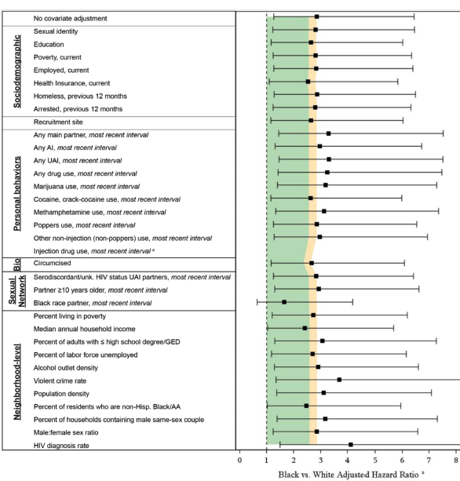
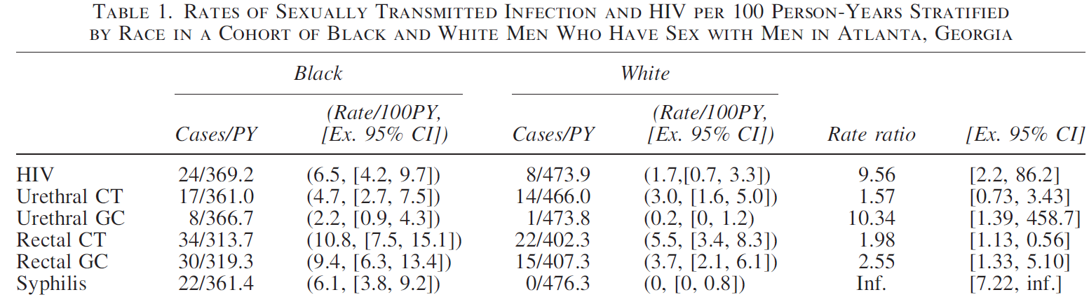
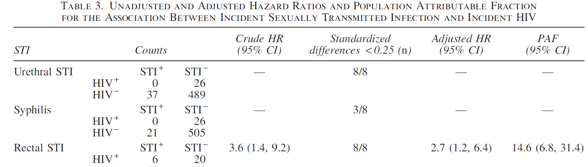
Sexual network factors, social determinants, neighborhood factors may supersede individual risk behaviors
Sullivan, Ann Epid 1014; Kelley, AIDS Research, 2015
Notes:
Patrick Sullivan, Eli Rosenberg, Colleen Kelly at EMory have helped us understand the importance of examing the possible exposures at the individual, dyadic and neighbor hood levels to explain racial disparities in hiv incidence in black and white msm in atlanta. Sexual network factors, social determinants, and neighborhood factors may supersede individual behaviors. A better understanding of the local overlapping epidemics of STI and HIV will be crucial for enhancing the design of HIV prevention inventions for MSM and understanding the causal contribution of stis toward hiv incidence

Slide 17
Gonorrhea Clinical Manifestations
 | Anatomic Site | Syndrome
Males | Urethra Epididymis Pharynx Rectum Eye Systemic (i.e., joint, blood, other sterile site) | Urethritis Epididymitis Asymptomatic, Nasopharyngitis Asymptomatic, Proctitis Conjunctivitis Disseminated Gonococcal Infection (DGI)
Females | Cervix Fallopian tube Urethra Epididymis Pharynx Rectum Eye Systemic (i.e., joint, blood, other sterile site) | Cervicitis Salpingitis/Pelvic Inflammatory Disease (PID) Urethritis Epididymitis Asymptomatic, Pharyngitis Asymptomatic, Proctitis Conjunctivitis Disseminated Gonococcal Infection (DGI)
Infants | Pharynx Eye | Asymptomatic, Pharyngitis Conjunctivitis (Neonatal Ophthalmia)
Notes:
The clinical manifestations of gonorrhea infections present a bit differently between males, females, and infants.
The acute clinical syndrome starts off as a lower genital tract infection, causing among other symptoms, urethritis, or inflammation of the urethra, in males, and cervicitis, or inflammation of the cervix in females. In infants born to an infected mother, perinatal transmission can lead to conjunctival infections.
The bacteria in the lower genital tract can also ascend to and cause an infection in the upper genital tract, as well. In men, this could cause epididymitis caused by disseminated bacteria, and for females, this could result in pelvic inflammatory disease.

Slide 18
Percentage of Men With Rectal and/or Pharyngeal Infections Not Detected if Only Urethral Infections were Diagnosed
Author | Location | Clinic Type | n | Prevalence CT GC |  | % Infections Missed CT GC
Kent | San Francisco, CA | MSM, STD | 6434 | 13.3% | 16.7% | 53 | 64
Gunn | San Diego, CA | STD | 7333 | ND | 15.8% | ND | 38
Schachter, Moncada | San Francisco, CA | STD | 1089 | 12.4% | 21.2% | 46 | 38
Bachmann | Birmingham, AL | HIV, STD | 142 | 12.1% | 7.9% | 84 | 63
Annan | Australia | HIV, STD | 3076 | 13% | ND | 62 | ND
Manavi | United Kingdom | STD | 443 | 10% | ND | 56 | ND
Templeton | Australia | STD | 1417 | 1% | ND | 68 | ND
Moncada | San Francisco, CA | STD | 899 | 11.5% | 16.5% | 47 | 26
Ota | Canada | MSM, STD | 248 | 7.7% | 11.7% | 79 | 65
Prevalence of Rectal GC
MSM 6.1%
Women 1.7%
Nonsexual health clinic 6%
Common among a range of populations, clinical settings
Dewart, STD 2018
Schachter J, Sex Transm Dis. 2011

Slide 19
Disseminated Gonococcal Infection (DGI)
Estimated to account for 0.5-3% of gonococcal infections
Risk factors: female, menses, pregnancy , terminal complement deficiency
Skin lesions (petechial or pustular) , tenosynovitis, polyarthralgia, septic arthritis
Perihepatitis, endocarditis, meningitis
+Blood cx tenosynovitis/arthralgia > septic arthritis
Mucosal site infection often asymptomatic (NAAT)
Antimicrobial susceptibility (AST) testing (culture)
Notes:
While incredibly rare, if N. gonorrhoeae invades the bloodstream, it becomes an invasive infection called disseminated gonococcal infection or DGI. If DGI develops, it will most often result in petechial or pustular skin lesions, asymmetric polyarthralgia, tenosynovitis, or septic arthritis. The infection is complicated occasionally by perihepatitis and rarely by endocarditis or meningitis. Some strains of N. gonorrhoeae that cause DGI can cause minimal genital inflammation.
Hospitalization and consultation with an infectious-disease specialist are recommended for initial therapy, especially for persons who might not comply with treatment, have an uncertain diagnosis, or have purulent synovial effusions or other complications. Examination for clinical evidence of endocarditis and meningitis should be performed.
The duration of treatment of DGI has not been systematically studied and should be determined in consultation with an infectious-disease specialist. Treatment for DGI should be guided by the results of antimicrobial susceptibility testing. Pending antimicrobial susceptibility results, treatment decisions should be made on the basis of clinical presentation.
Additional information:
* Women > men: effects of menses
• Proven (<50%), probable (80%) and suspected DGI
• Complement deficiency
• Rare complications: endocarditis, meningitis, osteomyelitis
* If DGI is suspected, NAAT or culture specimens from urogenital and extragenital sites, as applicable, should be collected and processed in addition to specimens from disseminated sites of infection (e.g., skin, synovial fluid, blood, and the CNS). All N. gonorrhoeae isolates should be tested for antimicrobial susceptibility.

Slide 20
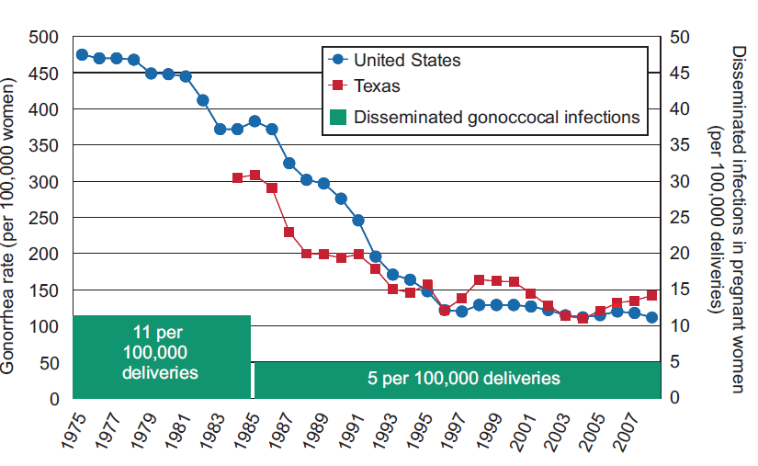
Disseminated Gonococcal Infection in Women
Bleich, Obstet Gynecol 2012

Slide 21
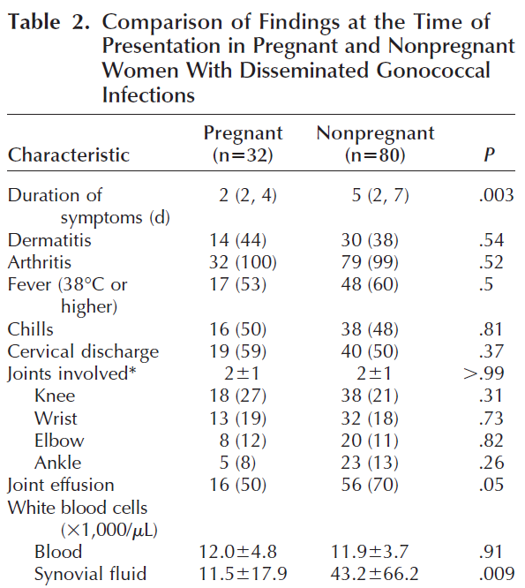
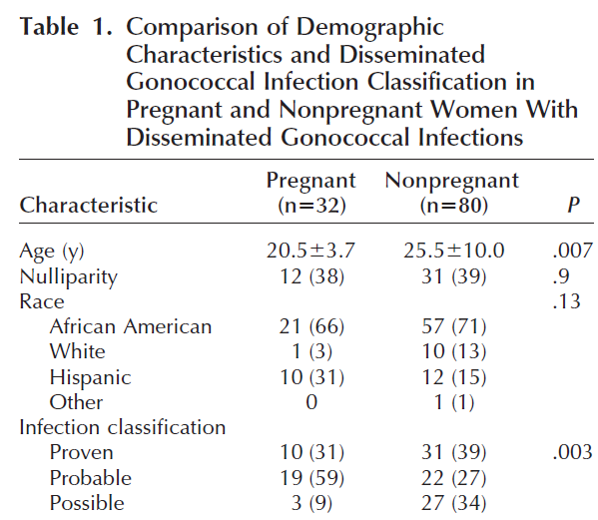
Disseminated Gonococcal Infection in Women
Proven- GC on cx or gram stain (sterile sites)
Probable- clinical DGI+ antimicrobial response + mucosal GC
Possible- clinical DGI + antimicrobial response
Bleich, Obstet Gynecol 2012

Slide 22
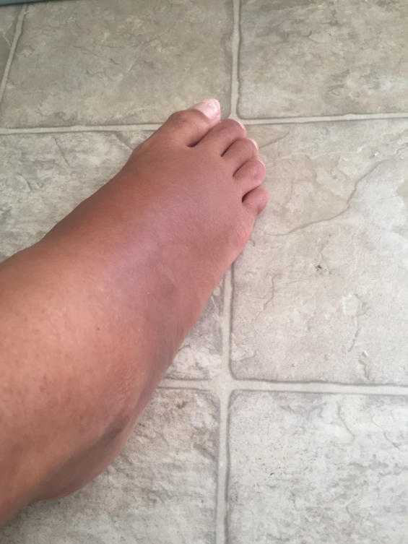
DGI Clinical Presentation
23 yo female G4P1 21 wks pregnant
Right ankle swelling, pain, migratory polyarthritis (left thumb/second finger, left wrist)
MRI ankle- osteomyelitis
Surgical joint exploration (no purulence)
Urine GC NAAT +
Blood cx, Joint cx neg
Throat cx+, vaginal cx neg
Ceftriaxone x 6 wks + azi x 1 gram

Slide 23
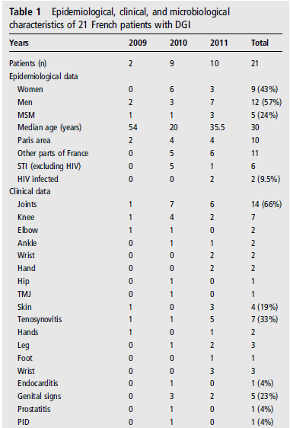
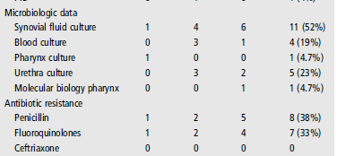
Changing Patterns of DGI
Belkacem, Sex Trans Infect 2013

Slide 24
DGI Surveillance Project
Current CDC surveillance doesn’t allow clinical reporting of DGI
Define the burden of disease for DGI among residents in two surveillance sites participating in active bacterial core surveillance (laboratory and population based).
Describe DGI epidemiology by conducting chart reviews of identified laboratory confirmed DGI cases (Surveillance areas: CA, GA)
  2015 – 2016 (retrospective)
  2017 (prospective)
To describe the molecular epidemiology of DGI by performing antimicrobial susceptibility and whole genome sequence testing on identified DGI isolates.

Slide 25
Number and Rate of Reported DGI Cases by Site in ABCs, 2015 – 2017
Case Counts
Rate (per 100,000 persons)
Year | CA | GA-DPH* | GA-MSA | Total
2015 | 1 | -- | 9 | 10
2016 | 0 | -- | 5 | 5
2017 | 1 | 3 | 7 | 11
Total | 2 | 3 | 21 | 26
Year | CA | GA-DPH* | GA-MSA | Total
2015 | 0.03 | -- | 0.16 | 0.11
2016 | 0 | -- | 0.09 | 0.05
2017 | 0.03 | 0.06 | 0.12 | 0.08
Total | 0.02 | 0.06 | 0.13 | 0.08
Site | Proportion of DGI Cases to Reported GC Cases (in Surveillance Area)
CA | 2 / 29,637 (0.007%)
GA-DPH* | 3 / 9,770 (0.031%)
GA-MSA | 21 / 29,323 (0.072%)
Total | 26 / 68,730 (0.0385)
*GA-DPH began prospective surveillance in 2017
Demographics- 42% female, MSW 15.4%, Male 38%
30% >45 yrs
15% CT+

Slide 26
Clinical Syndromes and Underlying Conditions (N=26)
Reported Clinical Syndromes
 | N | %
Bacteremia | 6 | 23.1
Septic Arthritis | 7 | 26.9
Septic Shock | 1 | 3.8
Bacteremia + Septic Arthritis | 1 | 3.8
Bacteremia + Endocarditis | 1 | 3.8
Bacteremia + Cellulitis | 4 | 15.4
Bacteremia + Petechial Skin Lesions | 1 | 3.8
Septic Arthritis + Tenosynovitis | 1 | 3.8
Petechial Skin Lesions + Polyarthalgia | 1 | 3.8
Bacteremia + Septic Arthritis + Polyarthralgia | 1 | 3.8
Septic Arthritis + Tenosynovitis + Bursitis | 1 | 3.8
Septic Arthritis + Cellulitis + Polyarthralgia | 1 | 3.8
Reported Underlying Conditions
 | N | %
None | 17 | 65.4
Immunosuppressive Therapy | 1 | 3.8
Systemic Lupus Erythematosus (SLE) | 1 | 3.8
Intravenous Drug Use, Past | 1 | 3.8
Previous History of GC | 2 | 7.7
Diabetes | 1 | 3.8
Cirrhosis + Alcoholism | 1 | 3.8
Immunosuppressive Therapy + SLE | 1 | 3.8
Cystic Fibrosis + Asthma + Smoker | 1 | 3.8

Slide 27
Disseminated Neisseria Infection/Eculizumab
Persons with terminal complement deficiencies have an increased risk of severe complications with encapsulated bacteria (Neisseria)
Eculizumab- recombinant, monoclonal C5 antibody approved for diseases associated with dysregulation of complement activation (Paroxysmal nocturnal hemoglobinuria, aplastic anemia)
Associated with 1000-2000 x of meningococcal disease (Menactra)
Several case reports of DGI Infection associated with eculizumab
Ongoing analysis of FDA adverse event reporting system (9 cases)
Glessing 2012, Hublikar S, Khandelwal 2017

Slide 28
Antimicrobial resistance challenges

Slide 30
Trends in Fluoroquinolone, Tetracycline, or Penicillin Resistance and Elevated MICs for Cefixime, Ceftriaxone, and Azithromycin by Year — GISP, 2000–2017*
Percentage
Ciprofloxacin-R
Tetracycline-R
Penicillin-R
Azithromycin-elevated MICs
Cefixime-elevated MICs
Ceftriaxone-elevated MICs
Year
*2017 data are preliminary as of 12/20/17 and report data collected during Jan-June, 2017

Slide 31
Percentage of Isolates with Elevated Ceftriaxone MICs, Elevated Cefixime MICs, and Elevated Azithromycin MICs, GISP, 2006–2017*
Percentage
4.5%
N=118
3.6%
N=190
*2017 data are preliminary

Slide 32
Percentage of Isolates with Elevated Azithromycin MICs by Sex of Sex Partner, GISP, 1993–2017*
Percentage
Change in definition of elevated MICs from
≥1 μg/ml to ≥2 μg/ml
Media change thought to increase MICs by one dilution
MIC=2: 4.1%
MIC=4: 1.7%
MIC=8: 1.2%
MSM: 7.0%
MSW only: 3.0%
MIC=2: 2.0%
MIC=4: 0.3%
MIC=8: 0.3%
MIC=16: 0.5%
*2017 data are preliminary.

Slide 33
Percentage of N. gonorrhoeae with Azithromycin Minimum Inhibitory Concentrations Above 1 μg/mL and 2 μg/mL, GISP 2012 – 2017*
 |  | 2012 | 2013 | 2014 | 2015 | 2016 | 2017*
Azithromycin | MIC ≥2 μg/mL | 0.3% | 0.6% | 2.5% | 2.6% | 3.6% | 4.5%
 | MIC ≥1 μg/mL | 2.4% | 3.6% | 7.1% | 6.8% | 11.1% | 8.6%
Cefixime | MIC >0.125 | 3.0% | 2.2% | 3.9% | 2.3% | 2.9% | 3.1%
Rising proportion of cases with elevated MICs to azithromycin
  High MICs is often more common in MSM, but not consistently isolated to MSM
Decreased susceptibility to cefixime remains uncommon
*Preliminary data

Slide 34
Percentage of Isolates with (A) Elevated Azithromycin MICs and (B) Elevated Ceftriaxone MICs with Other Resistance Phenotypes, GISP, 2017*
A
Azithromycin-RS† (n=11)
No overlap in 2017
B
Ceftriaxone-RS† (n=5)
Percentage
† Azithromycin-RS=reduced azithromycin susceptibility (MIC ≥2 µg/ml); ceftriaxone-RS=reduced ceftriaxone susceptibility (MIC ≥0.125 µg/ml)
*2017 data are preliminary as of 12/20/2017 and report data collected during Jan-June, 2017 ; NOTE: Resistance categories are not mutually exclusive

Slide 35
Combating Antibiotic-Resistant Bacteria (CARB) and Advanced Molecular Detection (AMD)
Strengthen surveillance (GISP & SSuN)
Regional laboratory reference network (ARLN)
  Maryland, Tennessee, Texas, Washington
Strengthening U.S. response to resistant gonorrhea (SURRG)
  Build rapid detection and response capacity to rapidly detect resistant GC in selected jurisdictions
  AST/epidemiological network approaches
Economic impact of resistance

Slide 36
Treatment Optimization

Slide 37
Gonorrhea
United States
  Ceftriaxone 250 mg IM in a single dose PLUS
  Azithromycin 1 g orally in a single dose
United Kingdom
  Ceftriaxone 500 mg IM in a single dose PLUS
  Azithromycin 1 g orally in a single dose
Europe (European CDC)
  Ceftriaxone 500 mg IM in single dose PLUS
  Azithromycin 2 gm orally in a single dose
Japan
  Ceftriaxone 1 gm IV/IM in a single dose
Optimize therapeutic regimen
  PK/PD (site of penetration)
  Concentration dependent vs independent regimen
  Bacterial burden
  Mutational frequency to resistance
  Resistance suppressive targets do not guarantee eradication
Novel agents (Zoliflodacin, Gepotidacin)
Treatment Failures
  Dual therapy in UK (Fifer 2016)
  Ceftriaxone MIC of 0.5mg/L, azithromycin MIC of >256mg/L in UK, Australia (March 2018)

Slide 38
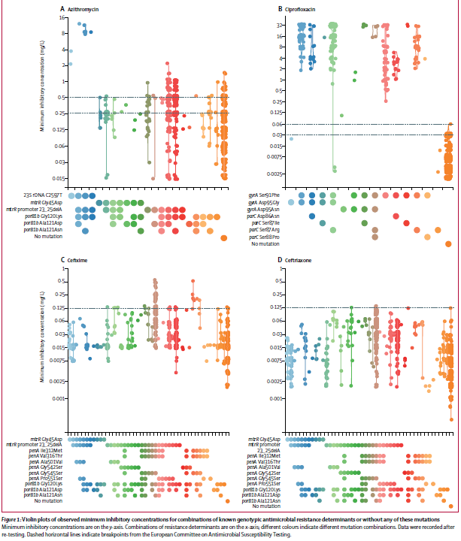
Genotypic Antimicrobial
Resistance Determinants
Use of WGS in conjunction with epidemiological and phenotypic data
Enhances understanding of the distribution of resistance clades
All but one isolate with azi MIC at least 2, had 2597C-T, not seen in isolates <2
Harris, Lancet Infect Dis 2018

Slide 39
Global Antibiotic Research and Development Partnership
Launched by WHO and Drugs for Neglected Disease Initiative in 2016
Draft of acceptable GC target product profiles and timeline
Research and Development plan
  Accelerate the development of a new clinical entity
  Evaluate the potential of existing antimicrobials and combinations
  Explore co-packaging and fixed dose combinations
  Development of simplified treatment guidelines
Alirol, PloS Med 2017

Slide 40
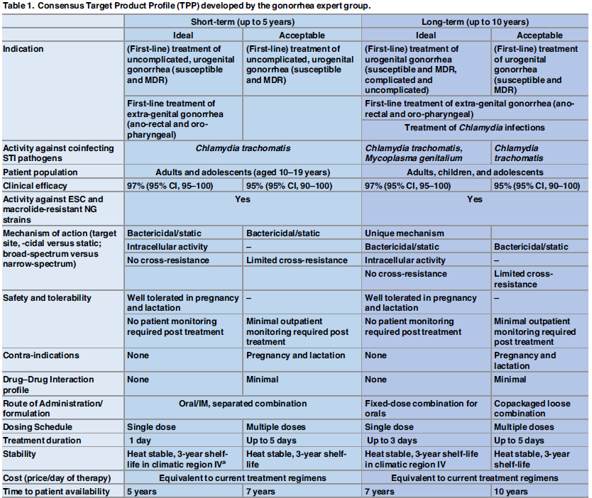

Slide 41
N. gonorrhoeae: Protection from responses to meningitis vaccine?
Outer membrane vesicle meninogococcal group B vaccine
  80-90% homology between N. gonorrhoeae and N. meningitidis
  Case-control study (~1:10) in New Zealand
    Cases: Gonorrhoea-positive only
    Controls: Chlamydia-positive only
 | Adjusted OR | VE (95% CI)
Vaccinated vs unvaccinated 2004-2014 | 0.69 (0.61-0.79) | 31% (21-39)
Vaccinated vs unvaccinated: 2004-2009 | 0.80 (0.66-0.98) | 20% (2-34)
Vaccinated vs unvaccinated: 2010-2014 | 0.91 (0.75-1.11) | 9% (0-25)
Petousis-Harris et al, Lancet 2017

Slide 42
Gonorrhea Prevention Efforts
Enhance international surveillance efforts
Screening of populations at risk for infection
Clinical presentation variable/Role of extra-genital infection
Partner Services/Social Determinants of Health
Effective treatment
  Dual vs single therapy (PK/PD, site of infection)
  Antimicrobial stewardship
  Novel therapeutics
  GARDP initiative

Slide 43
Acknowledgements
Global Antibiotic Research and Development Partnership
Lizzie Torrone
Emily Weston

